Slide 1
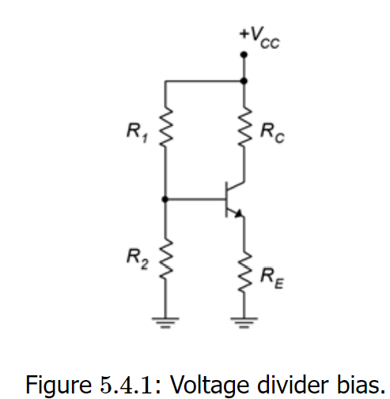
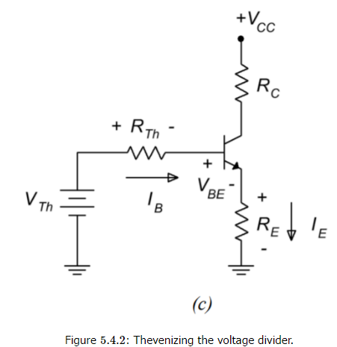
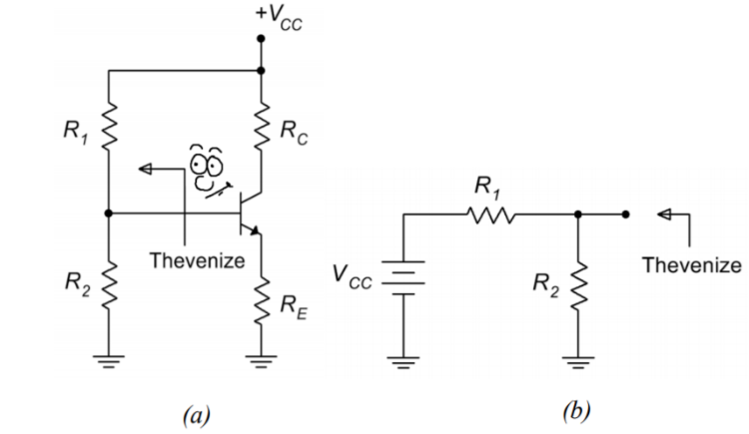
5.4: Voltage Divider Bias
to avoid issues with a second power supply, this base voltage is derived from the collector power supply via a voltage divider. The bias template is shown in Figure 5.4.1
Let's derive the equations for the load line. First, let's consider the saturation and cutoff endpoints. For saturation, assume VCEVCE goes to 0. What resistances are left to limit the current?
VCE (cutoff) occurs when IC=0 and that means that there will be no potentials across RC and RE. Therefore, VCE takes on the entire available source voltage.
The key to finding the Q point (and pretty much any other current or voltage in the circuit) is to find IC. To simplify the process, Thevenize the voltage divider as shown in Figure 5.4.2

Slide 2
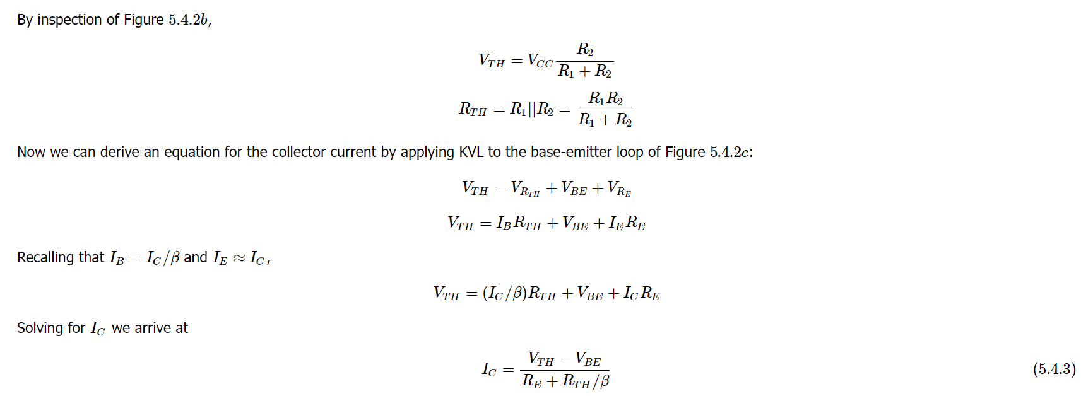
If we assume that the voltage divider of R1 and R2 is lightly loaded, in other words, that the divider current is much, much less than the base current, finding IC is easy. The divider voltage yields the base voltage. We then subtract the 0.7 volt drop on the base-emitter and what's left drops across RE. From there it's one short application of Ohm's law to get IE, which is approximately equal to IC. But how do we know if the divider is lightly loaded in the first place without going through the Thevenin equivalent? Looking at Equation 5.4.3, as long as RE≫RTH/β, we can ignore the second term in the denominator, leaving us with our quick approximation. Given typical values for β, as long as R2 is not much larger than RE, the approximation will be reasonably accurate.
Once IC is obtained we can find the transistor's collector-emitter voltage, VCE

Slide 3
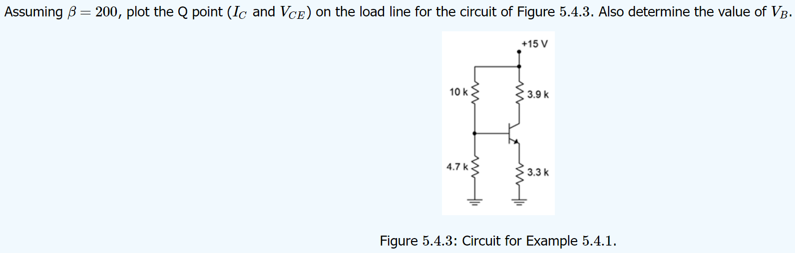

Slide 4

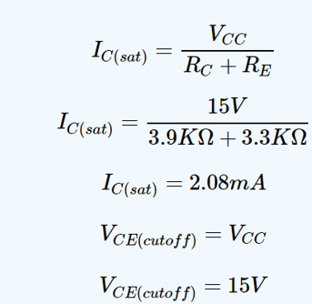
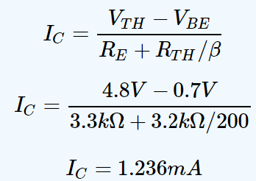
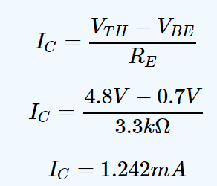
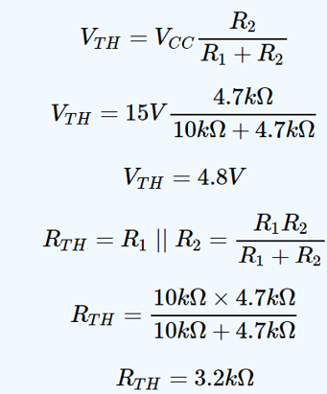
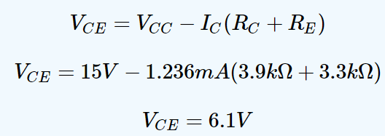

Slide 5
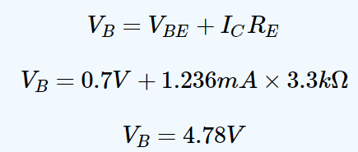
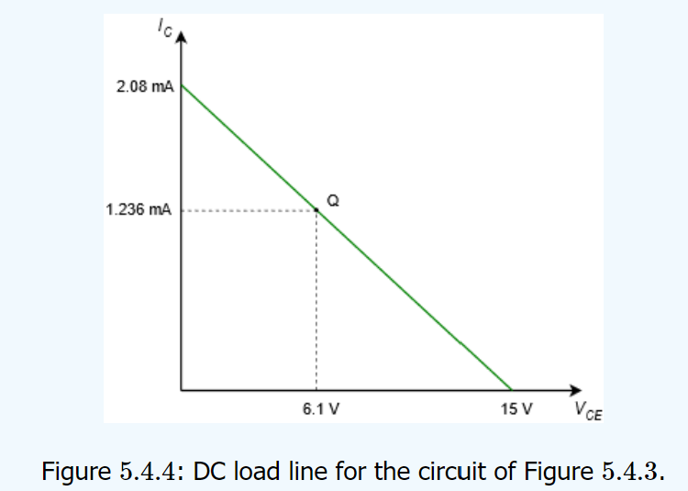
As far as finding VB is concerned, a decent approximation would be the value of VTH because we have determined that the divider is lightly loaded. In a more general sense, we could also find the drop across RE and then add VBE. The approximation yields 4.8 volts and the more accurate method yields

Slide 6
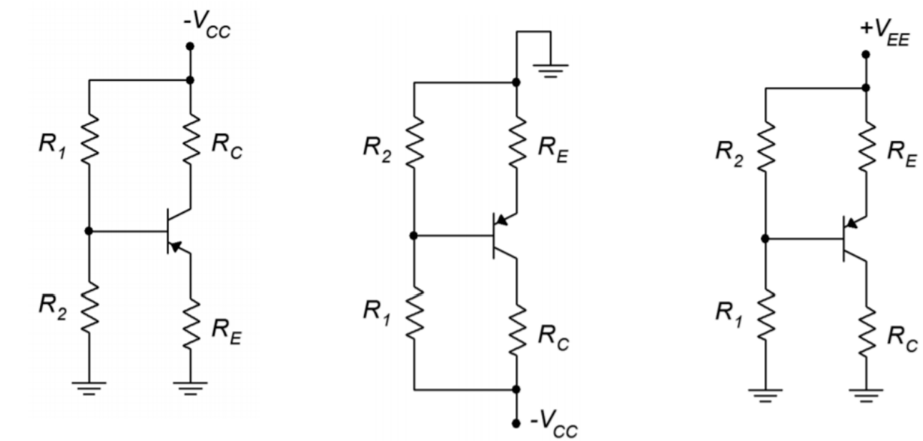
5.4.2: PNP Voltage Divider Bias
To create the PNP version of the voltage divider bias, we replace the NPN with a PNP and then change the sign of the power supply. As mentioned
with the two-supply emitter bias, these circuits are usually flipped top to bottom resulting in the flow of DC current going down the page. All of the
currents and component voltages are unchanged except that their directions and polarities are reversed. The current equations and so forth remain
valid. Something a little odd-looking happens with the voltage divider bias, though: we end up with ground being the most positive potential and a
negative supply at the bottom of the schematic. It works, but it's an issue if we're using a traditional positive supply elsewhere in the circuit. After all, why have two supplies where one will do? It turns out that we can make a positive supply version fairly easily. All we need to do is add the
magnitude of the negative source voltage to the ground and power connections. This progression is shown in Figure 5.4.5.
Figure 5.4.5: Progression of PNP voltage divider bias circuit. a. Direct conversion from NPN. b. Top-to-bottom flip. c. DC supply offset added to achieve a positive supply.

Slide 7
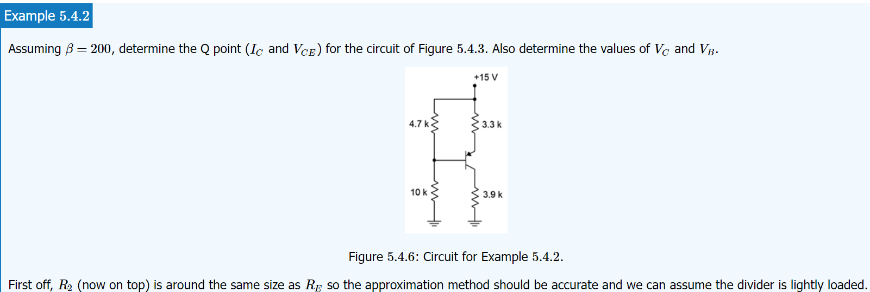

There is nothing magic about this procedure. In essence, all we've really done is renamed the reference point. All of the individual component voltages remain unchanged.
For example, looking at Figure 5.4.5c versus 5.4.5b, it is still the case that the top connection to RERE is more positive than the bottom connection to RC by the
voltage VCC (although we did rename the supply to VEE to be consistent with where it's connected). What has happened is that all ground-referenced (i.e., single subscript) voltages have changed. For example, VB in Figures 5.4.5a5.4.5a and 5.4.5b5.4.5b is the voltage across R2R2. In contrast, VBVB in Figure 5.4.5c5.4.5c is the voltage across R1R1. That makes sense. If we move the reference then any voltage that is measured against the reference will change.

Slide 8
